Slide 1
Phase 0 Assignment
Flight School 2020

Slide 2
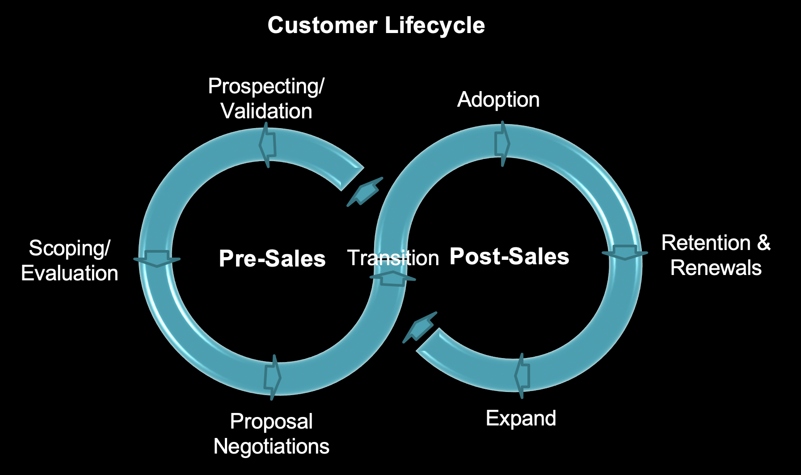
You are here!
Notes:
Here is the point we are concentrating on in this assignment.

Slide 3
Agenda
Reviewing the assignment
Reviewing the time line
Some missing pieces
Your assignment
Your resources
Questions and Discussion
Notes:
First we’ll take a look at the assignment verbiage that you received before flight school started
Next we’ll review the time line of MegaCorp engagement that you received before flight school
Some missing pieces… parts of this time line don’t make sense… let’s drill into them.
… and of course these missing pieces become your team assignment.
We’ll give links to some resources you can use
And we’ll make time for any questions/thoughts.

Slide 4
Agenda
Reviewing the assignment
Reviewing the time line
Some missing pieces
Your assignment
Your resources
Questions and Discussion

Slide 5
MegaCorp has been touting the benefits of creating an “Electricity Value Network,” in which digitization allows for visualization and predictive ML using sensor data from the plant.
A great example is Bord Gáis Energy’s Whitegate power plant, a 445-MW gas combined-cycle plant. There are sensors across the plant that provide round-the-clock monitoring. ML can be used to improve plant efficiency.
Whitegate engineers desire a single, consolidated picture of Whitegate’s performance and how to run the plant most optimally.
MegaCorp has Data Engineers with Python skills and Data Scientists with R skills.
They have a cloud strategy of implementing in either AWS or Azure to reduce capital expenditures and time spent on DevOps.
Notes:
The “official” assignment statement.

Slide 6
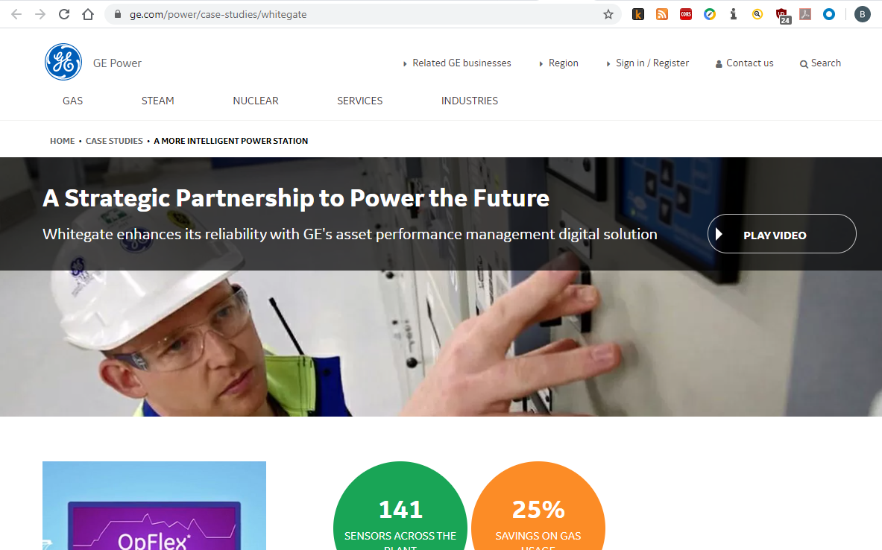
Notes:
By the way, that hint about Whitegate is genuine!

Slide 7
Agenda
Reviewing the assignment
Reviewing the time line
Some missing pieces
Your assignment
Your resources
Questions and Discussion

Slide 8


MegaCorp
From Zero to AI Ecosystem in 90 days.
VP of
Operations
Sally, the VP of Operations, has two problems with one of her premier assets:
controlling cost
maximizing revenue
Director of AI/ML
Day One
Sally asks Director Tai to gather all the data for the Whitegate power plant.

Slide 9

MegaCorp
From Zero to AI Ecosystem in 90 days.
Director of DS
Tai asks her PM Andy how long it would take to put an AI Ecosystem, capable of generating value, into place.
Day One
Director of PM
Andy remembers attending a Spark AI Summit recently and a lot of companies were using Databricks as the foundation of their AI Ecosystems

Slide 10

MegaCorp
From Zero to AI Ecosystem in 90 days.
Director of PM
Andy ask Ali his Sys Admin to estimate how long it will take to stand up a Databricks environment
Day One
Sys Admin
Day One
Ali checks into it and realizes he can have a Databricks environment up in multiple cloud environments in LESS THAN AN HOUR

Slide 11

MegaCorp
From Zero to AI Ecosystem in 90 days.
Sys Admin
Ali lets Vida, a Data Engineer, know Databricks is ready to use
Day One
Data Engineer
Day One
Vida uses a Databricks Workshop, put on by her friendly neighborhood Databricks Solutions Architect, to quickly build out an environment to manage Data Engineering, Data Science and Premier Assets Experts

Slide 12

MegaCorp
Brainstorming
From Zero to AI Ecosystem in 90 days.
Problem defined by Management
Data Engineer
Vida uses the environment to quickly integrate all the the data on the premier asset.
Day One
Data Scientist
Day One
Alaina starts building out features about the premier asset.

Slide 13

MegaCorp
From Zero to AI Ecosystem in 90 days.
Day Two
Data Scientist
Alaina leverages the new features and reviews them with Matei.
Day Two
Subject Matter Expert
Matei reviews the features and requests additional features to certify model.

Slide 14
MegaCorp
From Zero to AI Ecosystem in 90 days.
Data Scientist
Alaina asks Vida to get some more data.
Data Engineer
Vida adds streaming data to the set available to Alaina.

Slide 15
MegaCorp
From Zero to AI Ecosystem in 90 days.
Day 3 - 89
Data Scientist
Alaina leverages the new features and reviews them with Matai.
Day 3 - 89
Subject Matter Expert
Matei reviews the features and and agrees they are good predictors

Slide 16
MegaCorp
From Zero to AI Edayscosystem in 90.
Deploy and evolve
Day 3-90
Sys Admin
Day 3-90
Deploys model as cloud service end-point.
Day 90

Slide 17
RACI
Responsible, Accountable, Consult, Inform
Role
Brainstorming
Story Definition
Iteration
Productionize
Director PM (Andy)
A
A
A
I
Data Scientist (Alaina)
I
I
R
R
Data Engineer (Vida)
I
I
I
R
SME (Matei)
R
I
R
I
Customer (Tai)
R
A
R
I

Slide 18
Agenda
Reviewing the assignment
Reviewing the time line
Some missing pieces
Your assignment
Your resources
Questions and Discussion

Slide 19
Some missing pieces…
It is true that customers often begin using Databricks before they contact us…
… but the time-line scenario has no Discovery meeting
… nobody asks Databricks to help with As-Is and To-Be
… the only Databricks involvement is a Workshop, which appears to be one-size-fits-all, since it was delivered on Day 1 without any prior Discovery meeting
The RACI chart has some inaccuracies, e.g.:
E.g., not all stakeholders are accounted for
No one is Accountable for productionizing
Etc.

Slide 20
Some missing pieces…
The SME (Matei) asks for more features, and subsequently the Data Engineer (Vida) has to stream in more data…
… but this is a sensor-based use case, and sensors typically only have the ability to send a very small amount of information, e.g., time and temperature…
… so what exactly is this streaming data that Vida adds? Where does it come from? What information does it contain? How does it help?

Slide 21
Agenda
Reviewing the assignment
Reviewing the time line
Some missing pieces
Your assignment
Your resources
Questions and Discussion

Slide 22
Your assignment
Prepare for a Discovery meeting
Write a Trip Report summarizing the Discovery meeting
Respond to MegaCorp with As-Is and To-Be architecture diagrams, and outline your proposed approach
As part of (3) above, propose sources of additional streaming (or not) data to satisfy Matei’s needs
Improve the RACI chart.

Slide 23
Your assignment… Discovery meeting
Research MegaCorp and prepare a list of questions. Your goals:
Understand current environment
Assess MegaCorp’s potential to succeed with Databricks
Uncover pain
Look for compelling event and executive sponsorship
Demonstrate that Databricks can be a trusted advisor

Slide 24
Your assignment… Trip Report
Prepare this internal Databricks document. Your goals:
Record the answers MegaCorp gave to your Discovery questions
Analyze the situation and suggest next steps

Slide 25
Your assignment… Architecture Diagrams
Prepare As-Is and To-Be architecture diagrams
Be prepared to present and defend your diagrams

Slide 26
Your assignment… Propose additional data sources
How could the sensor data be enriched?
Prove yourself as a trusted advisor

Slide 27
Your assignment… Improve the RACI chart
Use what you learned in the Discovery meeting
Guidelines:
Every task should have a Responsible person and an Accountable person
If you don’t Consult with anybody, are you likely to succeed?
If you don’t Inform anyone, will you gain adoption?

Slide 28
Agenda
Reviewing the assignment
Reviewing the time line
Some missing pieces
Your assignment
Your resources
Questions and Discussion

Slide 29
Your resources
Research:
https://www.ge.com/power/case-studies/whitegate
Discovery Questions:
https://drive.google.com/open?id=1HuixOdTZJ11L51yovPgTcMUHp4ze9QwA
Architecture Diagrams:
https://app.lucidchart.com/documents#/documents?folder_id=shared
Notes:
Don, will folks have permission for lucid chart? Will they have seen it yet?

Slide 30
Agenda
Reviewing the assignment
Reviewing the time line
Some missing pieces
Your assignment
Your resources
Questions and Discussion

Slide 31
Questions and Discussion
Prepare for a Discovery meeting
Write a Trip Report summarizing the Discovery meeting
Respond to MegaCorp with As-Is and To-Be architecture diagrams, and outline your proposed approach
As part of (3) above, propose sources of additional streaming (or not) data to satisfy Matei’s needs
Improve the RACI chart.

